Slide 1
02 | Creating web pages using Flask
Susan Ibach | Developer Evangelist
Christopher Harrison | Content Developer

Slide 2
Now that we know what a web application is...
…how do we send information to and from the user and server?

Slide 3
Module Overview
Talking to servers
Routing concepts
Adding functionality

Slide 4
Talking to servers

Slide 5
Talking to servers
Requests and responses
Request contents
Response contents
Making requests

Slide 6
Terminology warning!

Slide 7
Requests and responses
Request
Information the user sent to the server
Response
Information the server sends to the user

Slide 8



Making a request
I'd like to download a picture of a koala
www.adventure-works.com/SleepingKoala
"Here's the picture!"

Slide 9
Request contents
URL
Includes the query string
www.example.com/products?id=42
"Replayable"
Anyone with the URL can access the page
Header information
Sent behind the scenes
No size or type restriction
Forms
Files

Slide 10
Making requests
Two main "verbs"
GET
Can only send data in URL
Typically used to display forms or information
POST
Can send data in URL or header
Typically used to upload form data

Slide 11
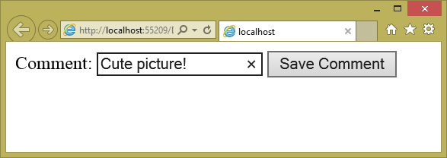
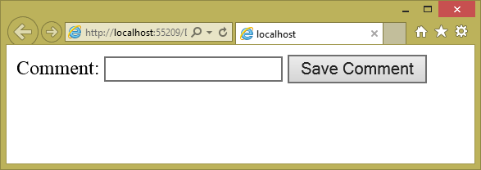
POST in action
I'd like to comment on that picture!
[GET] www.adventure-works.com/Comment
"Here's the form to use!"
[POST] www.adventure-works.com/Comment

Slide 12
Response contents
Header information
Used to indicate status codes, file types and other "behind the scenes" information
Content
Typically HTML, CSS or JavaScript

Slide 13
Routing concepts

Slide 14
Routing concepts
What is routing?
Routing and Flask
"Vanity URLs"

Slide 15
What is routing?
With many web technologies, users request specific pages
www.example.com/aboutus.html
www.example.com/register.aspx

Slide 16
Most modern applications shy away from calling specific pages
Request functionality instead
www.example.com/register
www.example.com/about
Advantages
Increased flexibility
Readable or "vanity" URLs
Search engine optimization

Slide 17
What is routing?
The server needs to understand what the user is requesting
www.example.com/register
This is routing
Translating a URL to desired item or function

Slide 18
Routing 101

Slide 19
Vanity URLs
Your name in lights!
www.example.com/speakers/SusanIbach
Why is this important?
Search engine optimization
Predictable URLs

Slide 20
Vanity URLs

Slide 21
Creating links

Slide 22
Creating links
To create a link you need the URL
Problem: The URL might change!
Solution: Ask Flask for the URL
"Don't hard code anything you can look up."

Slide 23
Adding links

Slide 24
What did we learn?
The difference between get and post
How to create custom URLs
How to send information to the user

Slide 25
What can we do with this?
Determine how best to share information with the world
Create custom URLs
Begin building web applications

